Slide 1
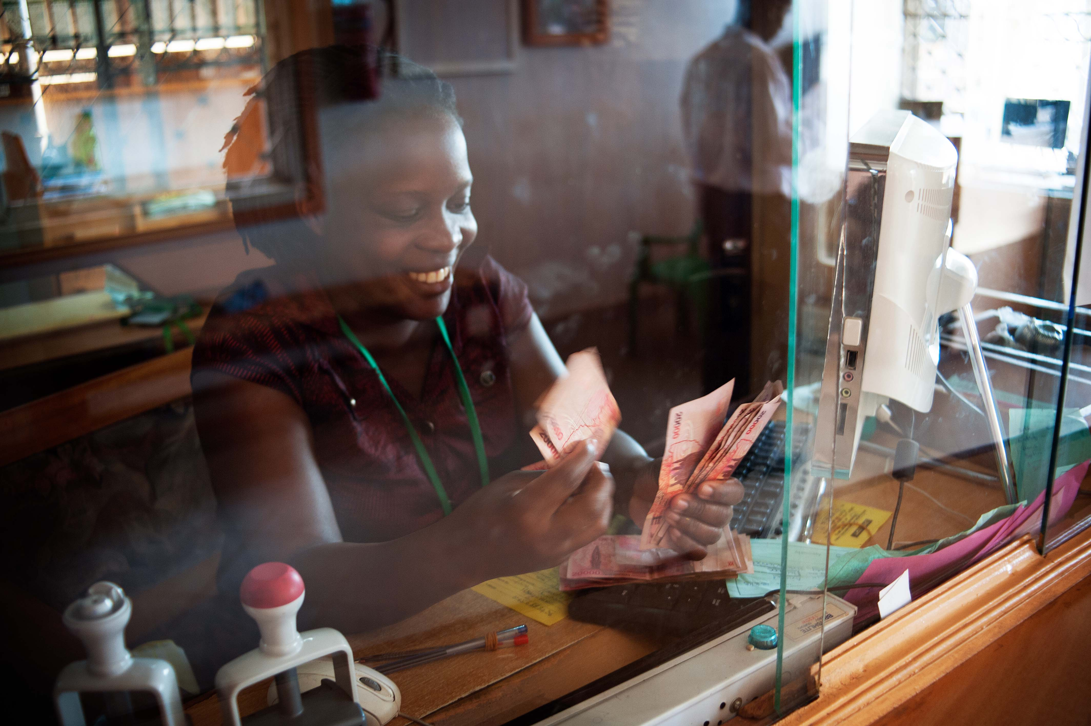
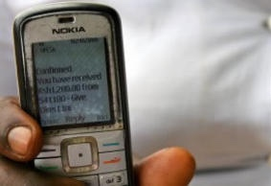
Potential Payoffs of Digital Wage Payments for Women and Employers
Carlos Acero, IPA Zambia
May 2018

Slide 2
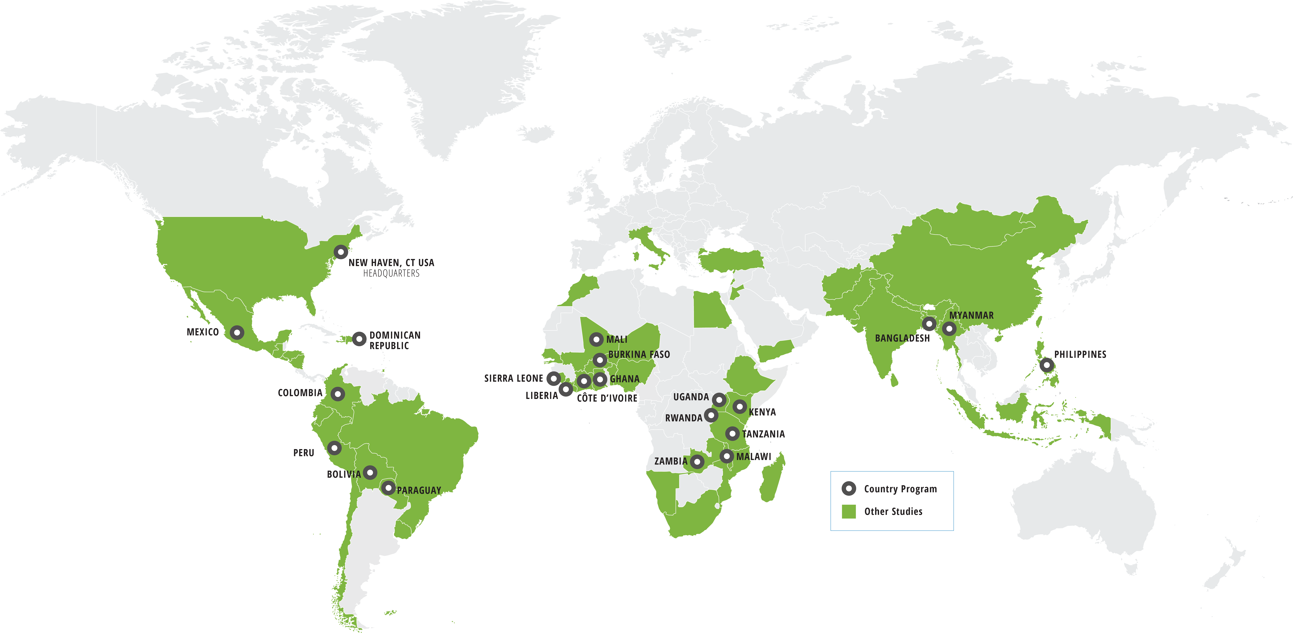
Overview
About IPA
The Challenges
Benefits of Digital Payments
Barriers to Adoption
What’s Left to Learn
Q&A
IPA Global Presence

Slide 3
Innovations for Poverty Action (IPA)
Innovations for Poverty Action (IPA): An international non-profit research & policy organization founded in 2002 that has worked in 51 countries with over 575 leading academics.
Our Mission: To discover and promote effective solutions to global poverty problems
Our Vision: More Evidence, Less Poverty
Notes:
IPA as pioneer with most experience in the field
We do research and promote effective evidence
We turn information into action
we need to combine the mindset of a venture capitalist, and that of a scientist, to pair the willingness to innovate with a rigorous methodology to identify impacts.
_____________
And that is why IPA was created in 2002, by Dean Karlan, a professor of Economics at Yale.
IPA is a international non profit research organization with the mission to..
- In the last 50 years, $3 trillion have been spent on programs to fight poverty
There are 1.2 billion people still live in extreme poverty – how do we ensure that the money spent to help them is used as cost effectively as possible?

Slide 4
IPA Zambia
Established in 2010
29 studies across Agriculture, Education, Financial Inclusion, and Health sectors (16 complete, 13 in progress)

Slide 5
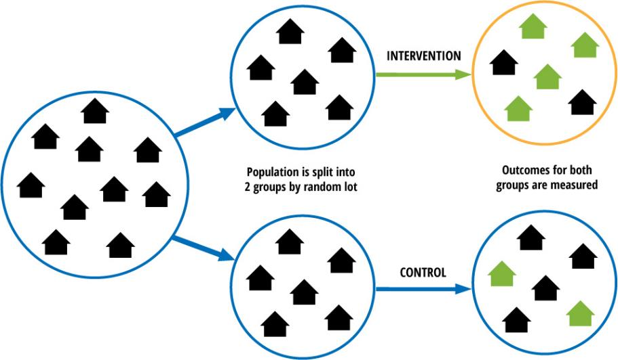
Measuring Impact: Randomized Control Trials
Notes:
Small meeting – quick overview of RCT – randomization eliminated selection bias
Big group expand to:
For example, you can evaluate the impact of a micro-credit program by randomly assigning communities to either a treatment group, that receives MC, and a control group, that will receive it only a couple of years later.
Ideally you would observe the same people at the same time, with and without the program. But since you cant clone people, this is the closest one can get to that.
There has in fact been 7 randomized evaluations across the world, which show that the two extreme claims I showed you earlier are not true.
What they show is that while MC can be a useful financial tool, and help some people create or expand a business, it does not lead to substantial improvements in income or social well-being. On the other hand there is no evidence that it harms people, and it also provides them with some more financial freedom, which is not negligible.
So our recommendation is not that MC should be stopped, but rather that donors and private investors interested in increasing the social impact of credit could use philanthropic money to encourage the design, piloting, and testing of more flexible credit products (see third policy lesson).
These evaluations have started having an impact on the debate, and discussions are more centered around the diversification of financial products. That said, it’s hard to say of course, but if they had been done earlier, it may be that some of the India crisis and shutting down of the sector would have even avoided.

Slide 6
Challenge: Cash payments are common, risky
Cash is risky for the employee
Can be stolen or lost
Harder to save (e.g., pressure to share, tendency to spend)
Cash is also risky and expensive for the employer
Bulk senders need to withdraw and transport large sums of cash, track payments
Staff time

Slide 7
Yet most people paid in cash
50% of adults globally and 85% of people in low-income countries say they still receive their wages in cash
Disproportionately women

Slide 8
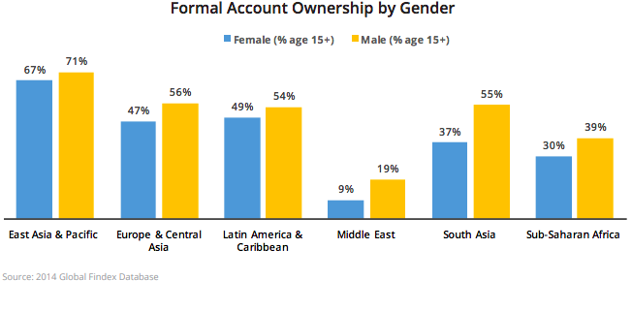
Challenge: Women’s Financial Inclusion
Globally, only 58 percent of women hold an account in a formal financial institution, compared to 65 percent of men.

Slide 9
Challenge: Women’s Financial Inclusion
Women disproportionately experience poverty
Path to greater women’s financial inclusion depends on a more gender inclusive financial system
System will need to address specific barriers faced by women on demand side and supply side
Notes:
Women disproportionately experience poverty, stemming from unequal divisions of labor and a lack of control over economic resources.
The path to greater women’s financial inclusion is dependent upon the creation of a more gender inclusive financial system that addresses the specific demand- and supply-side barriers faced by women, supported by an inclusive regulatory environment.

Slide 10
Challenge: Women’s Financial Inclusion
Notes:
Women disproportionately experience poverty, stemming from unequal divisions of labor and a lack of control over economic resources.
The path to greater women’s financial inclusion is dependent upon the creation of a more gender inclusive financial system that addresses the specific demand- and supply-side barriers faced by women, supported by an inclusive regulatory environment.

Slide 11
Digital payments = win-win
For employees
For employers
Lower cost of delivery (time savings)
May increase savings
More control
Lower cost of delivery
Lower risk
Notes:
- Density of agent networks and liquidity constraints but there was some adjustments in the initial months
Gender-based barriers are reduced in getting the money but access to phones are not exclusively (which paper?)
Women are much less likely to have legal documentation (which paper?)
Information sessions can make the difference (India’s case)

Slide 12
Lower Cost of Delivery
Digital Wage Payments
For employees
For employers
Receiving payments via mobile money or a bank card saves time.
Employers reduce cost of delivering salaries, staff time spent preparing salaries, and risk of transporting cash.
Notes:
So let’s talk about lower cost of delivery

Slide 13
Time-Savings
Digital Wage Payments
A study in Niger found that female cash transfer recipients time-savings were alone enough to offset the costs.
Household diet diversity was 9-16 percent higher and children ate 1/3 more of a meal per day, which was attributed to time savings.
Notes:
For example, on the employer side, there’s evidence from Afghanistan that the employer’s reduced per-employee cost of delivering salaries, staff time spent preparing the salaries, and risk of transporting large quantities of cash in a hazardous setting completely offset the fixed costs of the transition to digital payments in six months. MNO benefited too, as employees increased their phone use. (paper)

Slide 14
Lower Cost of Delivery
Digital Wage Payments
A study from Afghanistan found that costs of transitioning to digital payments were recovered by the employer within six months.
The shift to the mobile platform increased efficiency and transparency.
Notes:
So let’s talk about lower cost of delivery
On the employer side, there’s evidence from Afghanistan that the employer’s reduced per-employee cost of delivering salaries, staff time spent preparing the salaries, and risk of transporting large quantities of cash in a hazardous setting completely offset the fixed costs of the transition to digital payments in six months. MNO benefited too, as employees increased their phone use. (paper)

Slide 15
Savings
Digital Wage Payments
Evidence also suggests digital wage payments can increase savings
But evidence is limited, more research is especially needed in sub-Saharan Africa

Slide 16
Savings
Digital Wage Payments
In Bangladesh, preliminary findings showed increased savings among garment workers, mostly women, who received their wages digitally.
Electronic wage payments also helped workers better respond to shocks.
Notes:
Preliminary findings from Bangladesh showed increased savings among garment workers, mostly women, who received their wages digitally. (IGC blog)

Slide 17
Savings
Digital Wage Payments
In Afghanistan, employees accumulated money in their account instead of using less secure methods of savings, but did not save more overall.
However, electronic wage payments increased savings when payroll deductions were automatic; employees were defaulted into a saving a percentage of their income, but could opt out.
Sources: Blumenstock, Joshua E., Michael Callen, Tarek Ghani, and Lucas Koepke. "Promises and pitfalls of mobile money in Afghanistan: evidence from a randomized control trial." In Proceedings of the Seventh International Conference on Information and Communication Technologies and Development, p. 15. ACM, 2015; Blumenstock, Joshua Evan, Michael Callen, and Tarek Ghani. "Mobile-izing savings with automatic contributions: Experimental evidence on present bias and default effects in Afghanistan." (2016).
Notes:
Defaults In Afghanistan, employees let money accumulate in the account instead of using less secure, informal methods of savings (e.g. keeping cash under the mattress), but did not save more overall.
However, electronic wage payments can potentially increase savings by introducing automatic payroll deductions. (project summary)

Slide 18
More Control
Digital Wage Payments
Global evidence also suggests that digital payment may facilitate more more precise targeting of payments to recipients.
Appears to increase women’s control over their finances, with positive impacts on other domains.
Notes:
Digital payments allow for more precise targeting. When women in India received their wages into an account in their name instead of their husbands’, researchers saw an increase in the number of women working and their total earnings, especially among women particularly limited by prevailing gender norms. (project summary)
MPESA: Overall, an estimated 185,000 women changed occupations, and 194,000 households, primarily female-headed households, were lifted above the poverty line.

Slide 19
More Control
Digital Wage Payments
In India, more women worked and women earned more when they received their wages into an account in their name instead of their husbands’.
Effect was especially strong among women particularly limited by prevailing gender norms
Source: Innovations for Poverty Action. “Strengthening Women’s Financial Control Through Bank Accounts.” Accessed April 25, 2018 at https://www.poverty-action.org/study/strengthening-women%E2%80%99s-financial-control-through-personal-bank-accounts
Notes:
When women in India received their wages into an account in their name instead of their husbands’, researchers saw an increase in the number of women working and their total earnings, especially among women particularly limited by prevailing gender norms. (project summary)

Slide 20
More Control
Digital Wage Payments
Wage payments could be an on-ramp to mobile money which lowers the cost of informal risk-sharing, potentially allowing women to adopt higher-risk, higher-return income-earning strategies.
In Kenya, in areas where the mobile money platform M-PESA became more accessible, women were more likely to switch from farming to business occupations and to save more.
Source: Suri, Tavneet, and William Jack. "The long-run poverty and gender impacts of mobile money." Science 354, no. 6317 (2016): 1288-1292.
Notes:
Overall, an estimated 185,000 women changed occupations, and 194,000 households, primarily female-headed households, were lifted above the poverty line. (Note this was not wage payments, but still digital finance, which offers more control and reduces transaction costs, saves time, etc.)

Slide 21
Barriers: Practical Concerns
Digital Wage Payments
Agent/ATM liquidity
Firms fear resistance by workers to a new system
Gender-based barriers:
Mobile phone ownership
Legal documentation (IDs)
Financial and digital literacy
Notes:
Agent/ATM liquidity
In Afghanistan, the agents didn’t have enough cash on hand at first, so the users could not withdraw the amount they needed. (paper)
Gender-based barriers in mobile phone ownership, legal documentation, and financial and digital literacy
In India, just having access to an account was not enough; training was also needed.
(project summary)

Slide 22
Key Takeaways
Digital Wage Payments
Digital wage payments can give women control over the money they earn and encourage the use of formal financial services, while also reducing costs for businesses.
Save time and reduce risk for recipients
Impacts on savings and welfare outcomes more ambiguous
Evidence is still limited: more research is needed, especially in sub-Saharan Africa

Slide 23
Open Questions: What’s Left to Learn?
Digital Wage Payments
Can digital payments be effectively linked to other financial products?
Can the government catalyze the development of a broader ecosystem for mobile money through payments to public servants?
Notes:
Digitized payments provide a unique opportunity to offer microcredit while addressing some of its shortcomings, potentially reducing interest rates, default risk, and repayment issues. In the Dominican Republic, researchers are testing whether loans with automatic repayment through the government-to-person transfer program lead to more productive investments and higher profits and income, leading to higher consumption, wellbeing, and graduation from the transfer program.
Governments must pay their employees for states to function, but frequent delays and leakage of salary payments can undermine government effectiveness. In partnership with the Ministry of Education of Afghanistan, researchers are conducting a randomized evaluation to study whether mobile salary payments (MSPs) improve learning by increasing teacher attendance and morale. Could digitization of public servant wages potentially catalyze a broader ecosystem for mobile money?

Slide 24
The study featured in this presentation was made possible by the generous support of the American people through the United States Agency for International Development (USAID). The contents of this presentation are the responsibility of Innovations for Poverty Action and do not necessarily reflect the views of USAID or the United States Government.

