Slide 1
Understanding the roles of locus of control, self-efficacy and fatalism on grievance redressal for women in rural India
Findings for Stage 2 Survey
November 1, 2022
Sharon Barnhardt, Pavan Mamidi, Aayush Agarwal, Simran Saraf

Slide 2
Project Overview

Slide 3
Context & Timelines
STAGE 1: QUALITATIVE RESEARCH
While interventions have been instrumental in increasing women’s access and engagement with digital financial services (DFS), a focus on the societal, social, and individual barriers that limit women’s ability to raise complaints and resolve disputes is absent in the literature.
Our survey examines the roles of intrinsic factors such as locus of control, self-efficacy and fatalism in determining how women perceive and manage grievance redressal.
The results from this survey will lay the groundwork for experiments that test interventions to increase grievance redressal among women.
STAGE 2: SURVEY
22nd March
Pilot started
27th March
Pilot completed
24th April
Survey started
24th May
Survey completed
STAGE 3: INTERVENTION EXPERIMENTS

Slide 4
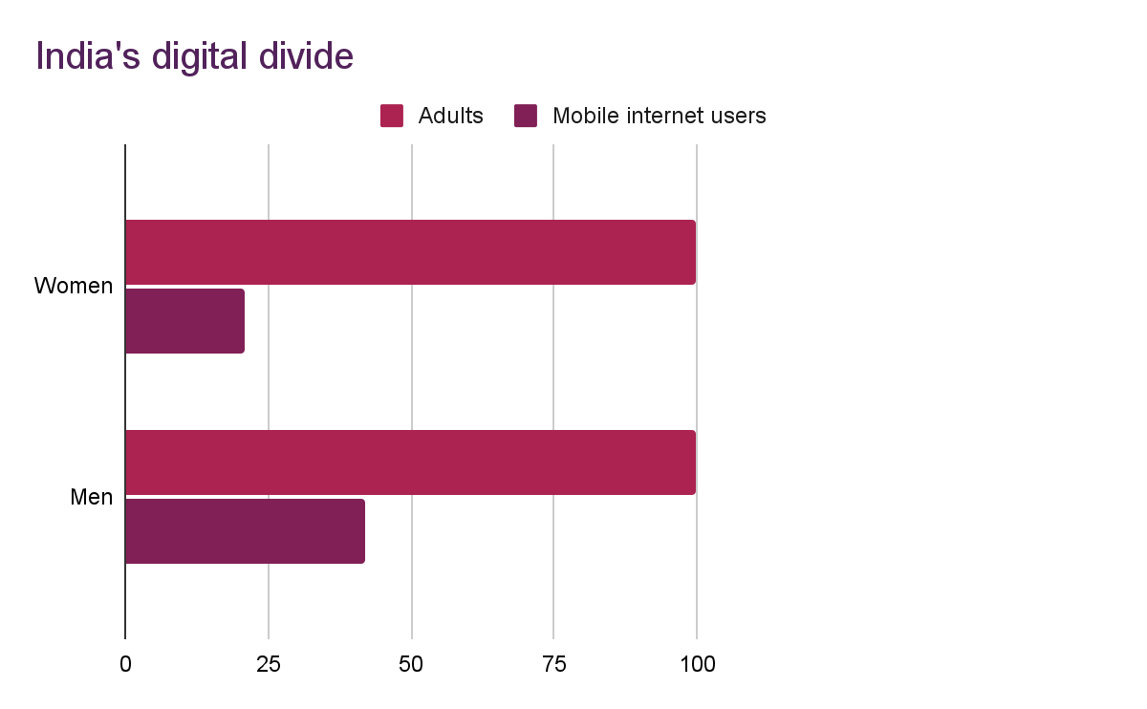
We sampled individuals who use digital financial services (DFS) to ask them about grievance redressal
Our surveyors talked to individuals who already use DFS, because we are interested in grievance redressal among users. Using DFS is rare among rural women.These respondents most closely represent the population that is already digitally engaged.
In Bihar, one Aspirational District out of 13 was sampled in a manner that districts with higher population were more likely to be selected. In UP, Varanasi district was purposively selected, given NITI Aayog’s interest in its Sewapuri block.
Two villages were randomly selected from each district after applying inclusion criteria, greater than average population and digital asset prevalence.
The number of households to be surveyed was based on village population. A fixed number of households were skipped after every successful survey to ensure the entire village was covered.
The first respondent in a village was female, and thereafter surveyors asked alternatively for male or female respondents.
Respondents were screened for age 18-55 years and usage of at least one of twelve DFS app or services.
For every 100 adult women, 21 use mobile internet
For every 100 adult men,
42 use mobile internet
sources: The Mobile Gender Gap Report
Notes:
Population-based weights were assigned to 13 aspirational districts in Bihar, and 1 was selected for data collection using the sample() function in R.
The inclusion criteria for village selection reduced the randomness of selection. These criteria ensured that villages would have enough respondents who met the surve’s eligibility criteria.
Gender requirement alternated with every alternate HH approached to ensure a gender-balanced sample.
Two villages were randomly selected from each district after applying inclusion criteria — greater than average population and digital asset prevalence (using Census data).

Slide 5
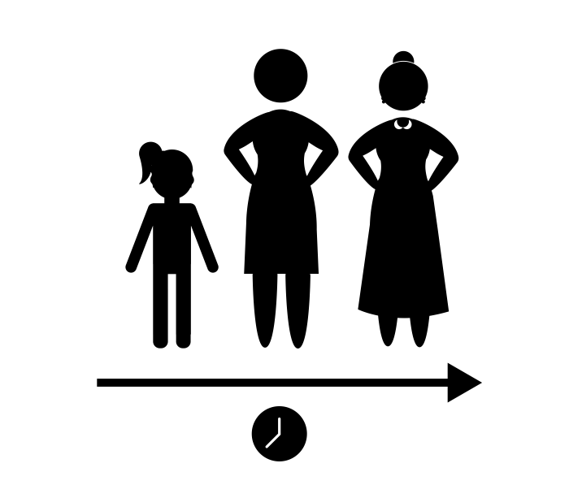
Our sample comprises 461 respondents from rural UP and Bihar
Total surveys attempted
519
Screened, consented, and
completed surveys*
461
% female
50%
Median age
31 years
% completed secondary school or higher
60%
% employed
45%
% married
78%
% with own smartphone
56%
Avg HH size
6.3

Slide 6
Sample demographics by gender
Gender differences are representative of the social realities of the study population
Indicators* | Female (N = 230) | Male (N = 231)
Age | 32.7 | 33.1
% Hindu | 93.0 | 90.9
Number Household Members | 6.4 | 6.2
% Married | 86.1 | 70.1
% Completed secondary school or higher | 53.0 | 67.1
% Household Income 10k or less | 60.4 | 50.2
% Own a smartphone | 37.8 | 73.5
% Primary income earner | 5.9 | 57.1
% Employed | 13.0 | 75.8
Female respondents are significantly more likely to:
Be married
Have HH income Rs.10,000 or less
Female respondents are significantly less likely to:
Have completed secondary education or higher
Own a smartphone
Be the primary income earner
Be employed
* values indicate mean (median in case of Age) of each indicator for females and males separately

Slide 7
Summary Statistics

Slide 8
Variables of interest
Outcomes
Knowledge about digital financial services
Attitudes about seeking grievance redressal
Stated behaviour
Self-directed redressal, seek help getting redressal, inaction, or a combination of these.
Primary predictors are standard psychometric scales
Locus of control (3 subscales each with a possible score in the range 8-40)
Internality: higher internal locus of control
Powerful Others: belief that one’s life is largely governed by external powerful individuals
Chance: belief that one’s life is largely a product of chance
Fatalism: propensity of individuals to believe in destiny and that whatever is meant to happen will happen
Self-efficacy: individual's belief in their capacity to act in the ways necessary to reach specific goals
Secondary predictors are directly related to DFS
Hassle aversion: whether individuals prefer to send money themselves or use an agent
Trust in DFS
Social norms surrounding DFS: awareness, usage, and family backlash
Additional information on variable descriptions, construction and types can be found in the Appendix.

Slide 9
Sample means of the outcomes and primary predictors
Outcomes
DFS redressal attitude 2:
sense of unfairness if issue occurs
(binary: 0,1)
0.7
DFS redressal knowledge
(0-4)
2.6
DFS redressal attitude 1: better to report issue
(binary: 0,1)
0.8
Self-redressal behaviour
(0-1)
0.9
Seek-redressal behaviour
(0-1)
0.4
Inaction behaviour
(0-1)
0.2
mid
high
high
high
low
low
Primary Predictors
Self-efficacy (10-50)
40.3
Fatalism
(6-30)
23.3
Locus of control - Internality
(8-40)
32.6
Locus of control - Powerful others
(8-40)
31.5
Locus of control - Chance
(8-40)
31.5
high
high
high
high
high
The only gender differences found were: higher mean for seek-redressl in women, lower mean for DFS knowledge in women and lower mean for LoC internality in women.
Notes:
These outcomes and primary predictors are not significantly different by gender - except seek-redressal behaviour (female = 0.39 and male = 0.32; p value for t-test = 0.038), knowledge (p value = .01) and Internality (female = 32.1 and male - 33.08; p value for t-test = 0.034)

Slide 10
Summary statistics by gender: DFS Knowledge, attitudes and behaviours
Women’s DFS knowledge score is slightly lower than men’s.
Women are slightly more likely to ask for help from friends and family for DFS redressal than men.
 | Means & Standard Deviations
Primary Predictors | Female (N = 230) | Male (N = 231)
DFS Knowledge: Number correct questions out of four possible** | 2.54 (0.71) | 2.70 (0.59)
Attitude 1: It is better to report confusion around a transaction (fraction yes) | 0.80 (0.40) | 0.79 (0.41)
Attitude 2: Feel a sense of unfairness if there is an issue with a transaction (fraction yes) | 0.68 (0.47) | 0.71 (0.46)
Redressal Behaviour 1: Fraction of real problems faced that the respondent reportedly handled by seeking redressal by himself or herself (self redressal) | 0.93 (0.18) | 0.93 (0.19)
Redressal Behaviour 2: Fraction of problems faced that the respondent reportedly handled by asking help from family or friends (seek redressal)** | 0.39 (0.38) | 0.32 (0.34)
Redressal Behaviour 3: Fraction of problems faced that the respondent reportedly handled by doing nothing (inaction) | 0.24 (0.35) | 0.26 (0.33)
**Difference in means is significant at 95% confidence level.
Notes:
The p-values are: Knowledge (0.012); Seek-redressal (0.038)
Redressal Behaviour 1: Fraction of problems faced that the respondent handled by seeking redressal by himself or herself. (self redressal)
Redressal Behaviour 2: Fraction of problems faced that the respondent handled by asking help from family or friends. (seek redressal)
Redressal Behaviour 3: Fraction of problems faced that the respondent handled by doing nothing. (inaction)

Slide 11
Summary statistics by gender: Primary predictors
Female and male respondents have similar levels on most of the predictors.
One difference is that women’s locus of control internality score is lower than men’s. Women feel like they have less control in their lives than men feel they have.
 | Means & Standard Deviations
Primary Predictors | Female (N = 230) | Male (N = 231)
Self-Efficacy Score: Score from 10-50 (higher = more belief in own capacity) | 40.2 (5.12) | 40.4 (5.31)
Fatalism Score: Score from 6-30 (higher = destiny is ruled by a higher power) | 23.5 (3.99) | 23.2 (4.35)
Locus of Control - Powerful Others: Score from 8-40 (higher = others have more control over what happens in her/his life) | 31.5 (4.94) | 31.5 (5.20)
Locus of Control - Internality: Score from 8-40 (higher = respondent has more control over what happens in his/her life) ** | 32.2 (4.62) | 33.1 (4.65)
Locus of Control - Chance: Score from 8-40 (higher = chance has more control over what happens in his/her life) | 31.7 (4.39) | 31.3 (5.05)
**Difference in means is significant at 95% confidence level.
Notes:
The p-values are: Internality (.034)

Slide 12
Summary statistics by gender: Secondary predictors
Most secondary predictors do not differ by gender either. There are two exceptions:
Women are more hassle averse when it comes to send money using an app.
Women are also less likely to report respect in the community for seeking redressal.
 | Means & Standard Deviations
Secondary Predictors | Female (N = 230) | Male (N = 231)
Hassle aversion: Prefer to pay an agent to send money versus send it with an app for free (fraction yes) *** | 0.6 (0.50) | 0.4 (0.49)
Trust in digital financial services: Score from 3-15 (higher = more trust in DFS) | 10.9 (2.45) | 11.0 (2.46)
Family DFS redressal norms - backlash for issues: Score from 2-10 (higher = more backlash from family) | 7.3 (1.75) | 7.2 (1.67)
DFS redressal norm - male awareness: Score from 1-5 (higher = perception of more awareness) | 3.8 (1.03) | 3.8 (0.96)
DFS redressal norm - female awareness: Score from 1-5 (higher = perception of more awareness) | 3.6 (1.12) | 3.5 (1.20)
DFS redressal norm - community outlook & respect: Score 1-5 for respect from community for redressal (higher = more respect)** | 3.6 (1.07) | 3.9 (0.99)
DFS usage norm 1 - male HH members prefer DFS: Score from 1-5 (higher = prefer DFS) | 3.7 (1.06) | 3.8 (0.95)
DFS usage norm 2 - female HH members prefer DFS: Score from 1-5 (higher = prefer DFS) | 3.5(1.13) | 3.4 (1.27)
***Difference in means is significant at the 99% confidence level, ** significant at 95% confidence level.
Notes:
The p-values are: Hassle aversion (.002), Norm 3 (.027)

Slide 13
Regression Results

Slide 14
The objective of this analysis is to:
Establish correlations between three individual-specific psychological factors (locus of control, self-efficacy, and fatalism), social norms, and self-reported Digital Financial Services (DFS) grievance redress knowledge, attitudes, and behaviours.
Control for the demographics that may introduce variation in the outcomes, such as smartphone ownership, gender, age, education, employment status, and household income.
Control for variables identified through qualitative research including previous experience with raising complaints through formal mechanisms and household division of labour.
Compare the results of these tests between male and female respondents.
Discover actionable insights that will inform interventions and test causality between the predictors and desired outcomes.

Slide 15
Outcome: DFS redressal knowledge
Ordered Logistic Regression
Outcome = Number of correct answers from 4 questions (Range 0-4; Mean = 2.6)
For women only, high DFS redressal knowledge is associated with:
High self-efficacy
Low backlash from family for redressal seeking
Counterintuitively, the model also found that high DFS redressal knowledge was associated with:
Fewer male household members who prefer using DFS to cash (overall sample)
Low Locus of control internality for women only
The difference in average DFS redressal knowledge by gender is not robust in a regression framework with control variables.
Regression tables for overall, female and male models can be found in the Appendix.
Notes:
Internality = The score of the internality subscale of the locus of control scale. Internality refers to a higher internal locus of control.
Powerful others = The score of the powerful others subscale of the locus of control scale. It refers to the belief that one’s life is largely governed by external powerful individuals.
Chance = The score of the chance subscale of the locus of control scale. It refers to the belief that one’s life is largely a product of chance.

Slide 16
Outcome: DFS redressal attitude 1 - better to report a problem
Logistic Regression: Outcome = Binary variables for pro-redressal seeking attitude (Data: 0 or 1; Mean = 0.8)
Attitude 1: If someone is ordering something small online or sending money through an app or netbanking and there is confusion about whether the transaction went through, is it better to report the problem or let it go?
Women who say it is better to report a problem have:
Higher internality (a locus of control subscale)
Low powerful others (a locus of control subscale)
Confoundingly, high DFS redressal attitude 1 was also associated with:
High fear of backlash from family for redressal seeking (for women only)
Low respect from community for seeking redressal (for women only)
High fatalism (overall sample)
Less female HH members preferring DFS (overall sample)
Regression tables for overall, female and male models can be found in the Appendix.

Slide 17
Outcome: DFS redressal attitude 2 - sense of unfairness
Logistic Regression: Outcome = Binary variables for pro-redressal seeking attitude 2 (Data: 0 or 1; Mean = 0.7)
Attitude 2: If you’re ordering something small online or sending money through an app or netbanking and there is confusion about whether the transaction went through, you feel a sense of unfairness and want to right the wrong done to you
DFS redressal attitude 2 does not significantly differ by gender
The model found that high DFS redressal attitude 2 was associated with:
High powerful others - LoC subscale (for women only)
High hassle aversion (for women only)
High backlash from family for redressal seeking (for men only)
Results for this outcome are inconsistent, suggesting that confounding variables may be distorting this attitude and its relationship with the predictors.
Regression tables for overall, female and male models can be found in the Appendix.

Slide 18
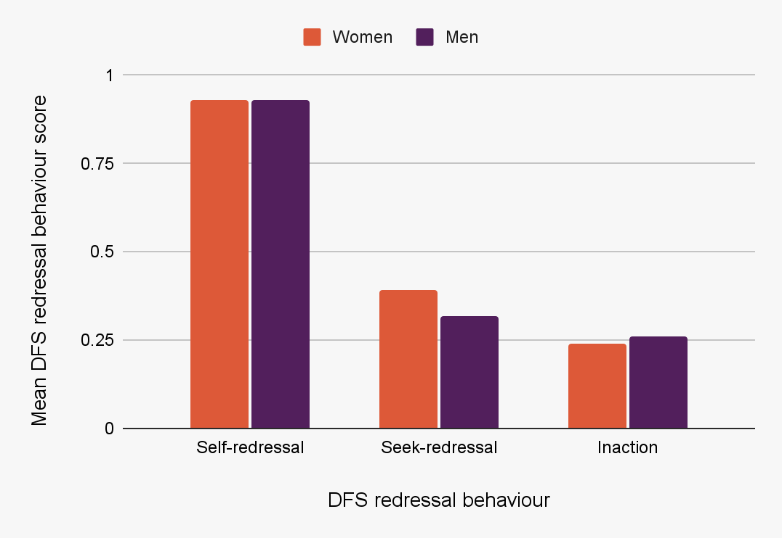
Outcome: DFS self-redressal behaviour
GLM with Logit Regression: Outcome = Score of total self-redressal behaviours (sought redressal themselves) divided by total number of challenges faced (Interval between 0 and 1; Mean = 0.9)
For women only, the regression analysis found that high DFS self-redressal behaviour was associated with:
Low fear of backlash from family
High empirical expectations that women in the community have high awareness of redressal mechanisms
Counterintuitively, high DFS self-redressal behaviour was also associated with:
High powerful others - LoC subscale (for men only)
Regression tables for overall, female and male models can be found in the Appendix.
Notes:
The question asked for determining self-redressal, seek-redressal, and inaction behaviour was:
“For each of the following DFS-related challenges, please select your preferred response to the issue:
1. Contact the DFS’ formal customer care (self-redressal)
2. Raise a complaint with government-provided redressal mechanism (self-redressal)
3. Do nothing to solve this issue (inaction)
4. Wait and see if the issue gets resolved by itself (inaction)
5. Contact my bank’s representatives (self-redressal)
6. Contact CSP/DFS agent (self-redressal)
7. Contact the recipient (self-redressal)
8. Ask for help from a family member (seek-redressal)
9. Ask for help from a friend (seek-redressal)
88. The respondent did not understand the question
99. I have not faced such an issue ever”
The respondents could select multiple options.

Slide 19
Outcome: DFS seek-redressal behaviour
GLM with Logit Regression: Outcome = Score of total seek-redressal behaviours (ask friends or family for help) divided by total number of challenges faced (Interval between 0 and 1; Mean = 0.4)
Regression analysis found that high DFS seek-redressal behaviour was associated with:
High powerful others - LoC subscale (overall)
More male HH members preferring DFS over cash (for women only)
More female HH members preferring DFS over cash (for men only)
When separating the model for friends or family, we found significant findings for the family outcome and HH usage norms
Confoundingly, high DFS seek-redressal was also associated with:
High chance - LoC subscale (for women only)
Regression tables for overall, female and male models can be found in the Appendix.

Slide 20
Outcome: DFS inaction behaviour
GLM with Logit Regression: Outcome = Score of total inaction behaviours (do nothing / wait and see) divided by total number of challenges faced (Interval between 0 and 1; Mean = 0.2)
DFS inaction does not significantly differ by gender
The model found that high DFS inaction behaviour was associated with:
Lower internality - LoC subscale (overall sample)
Lower powerful others - LoC subscale (for men only)
More male HH members preferring DFS (for women only)
Less female HH members preferring DFS (for women only)
Regression tables for overall, female and male models can be found in the Appendix.

Slide 21
Discussion

Slide 22
Actionable insights for the female subgroup
IV | Female Subgroup Insight
Higher self-efficacy | Higher DFS redressal knowledge
Higher internal locus of control | Higher attitude of ‘better to report if there is confusion around a transaction’ Lower inaction when facing issues
Higher reported fear of family backlash for facing financial issues | Lower DFS redressal knowledge Higher attitude of ‘better to report if there is confusion around a transaction’ Lower self-redressal behaviour
Perception of higher awareness of DFS among women in community (second-order belief) | Higher self-redressal behaviour
Higher reported women in household preferring DFS over cash | Higher seek-redressal behaviour Lower inaction
We have narrowed down insights by how consistent and actionable they are in terms of intervention design.
Increasing self-efficacy and internality could enable us to:
Increase knowledge
Decrease inaction
Changing social norms around family backlash, women’s DFS usage and women’s awareness of redressal could in turn:
Increase self-redressal behaviour
Increase seek-redressal behaviour
Decrease inaction

Slide 23
Contact us
Website: www.csbc.org.in
Email: csbc@ashoka.edu.in
Twitter: @CSBCAshokaUniv
LinkedIn: @Centre for Social and Behaviour Change
This research was conducted by the Centre for Social and Behaviour Change, Ashoka University, supported by a grant from IPA’s Consumer Protection Research Initiative.

Slide 24
Appendix

Slide 25
Variable construction: Outcomes
Outcome variable | Data type | Construction | Sample average
DFS redressal knowledge | Count (0, 1, 2, 3 or 4) | Count for the number of knowledge questions relating to DFS (e.g., filing a complaint, escalating a complaint and constitutional rights) that were answered correctly | 2.6
DFS redressal attitude 1 | Binary (0 or 1) | Pro-redressal seeking attitude if they believe it is better to report confusion around a transaction | 0.8
DFS redressal attitude 2 | Binary (0 or 1) | Pro-redressal seeking attitude if they feel unfairness and want to right the wrong done when there is confusion around a transaction | 0.7
Self-redressal DFS behaviour | Interval (between 0-1) | Total self-redressals (conduct redressal behaviour themselves) divided by the number of challenges faced (out of 5 possible challenges) | 0.9
Seek-redressal DFS behaviour | Interval (0 or 1) | Total seek-redressals (ask for help from others) divided by the number of challenges faced (out of 5 possible challenges) | 0.4
Inaction DFS behaviour | Interval (0 or 1) | Total inactions (do nothing) divided by the number of challenges faced (out of 5 possible challenges) | 0.2
Notes:
Redressal Behaviour 1: Fraction of problems faced that the respondent handled by seeking redressal by himself or herself. (self redressal)
Redressal Behaviour 2: Fraction of problems faced that the respondent handled by asking help from family or friends. (seek redressal)
Redressal Behaviour 3: Fraction of problems faced that the respondent handled by doing nothing. (inaction)

Slide 26
Variable construction: Primary predictors
Primary predictors | Data type | Construction | Sample average
Locus of control - Internality | Ordinal (score from 8-40) | Sum of the agreement to statements from 8 questions | 32.6
Locus of control - Powerful others | Ordinal (score from 8-40) | Sum of the agreement to statements from 8 questions | 31.5
Locus of control - Chance | Ordinal (score from 8-40) | Sum of the agreement to statements from 8 questions | 31.5
Self-efficacy | Ordinal (score from 10-50) | Sum of the agreement to statements from 10 questions | 40.3
Fatalism | Ordinal (score from 6-30) | Sum of the agreement to statements from 6 questions | 23.3

Slide 27
Variable construction: Secondary predictors
Secondary predictors | Data type | Construction | Sample average
Hassle aversion | Binary (0 or 1) | 0 if respondents prefer to send money themselves with an app 1 if respondents prefer to send money through an agent with a fees | 0.5
DFS trust | Ordinal (score from 3-15) | Sum of the agreement to trust in DFS statements (relating to preference for DFS over cash, comfort making transaction for large amounts, belief in formal customer service) is used to create a score from 3 questions | 10.9
DFS usage norms (2 separate variables) | Ordinal (score from 1-5) | Agreement for male HH members preferring DFS over cash Agreement for female HH members preferring DFS over cash | 3.8 3.4
DFS redressal norms (3 separate variables) | Ordinal (score from 1-5) | Agreement for “Male members of my community are well aware of consumer redressal related processes and laws” Agreement for “Female members of my community are well aware of consumer redressal related processes and laws” Agreement for “If I seek redress for my DFS problems myself, I will be respected within my community.” | 3.8 3.5 3.8
DFS family redressal norms | Ordinal (score from 2-10) | Sum of the agreement for 2 questions relating to backlash from family for redressal seeking If I seek redress for my DFS problems, I may receive backlash from my family members. If I face any money-related issues while using DFS, I may receive backlash from my family members. | 7.2

Slide 28
Hypotheses: Primary predictors
Primary predictors | Hypotheses for pro-redressal knowledge, attitudes and behaviour (KABs)
Locus of control - Internality | Pro-redressal KABs are positively associated with high internality
Locus of control - Powerful others | Pro-redressal KABs are negatively associated with high powerful others
Locus of control - Chance | Pro-redressal KABs are negatively associated with high chance
Self-Efficacy | Pro-redressal KABs are positively associated with high self-efficacy
Fatalism | Pro-redressal KABs are negatively associated with high fatalism

Slide 29
Hypotheses: Secondary predictors
Secondary predictors | Hypotheses for pro-redressal knowledge, attitudes and behaviour (KABs)
Hassle aversion | Pro-redressal KABs are negatively associated with high hassle aversion
Trust in DFS | Pro-redressal KABs are positively associated with high trust in DFS
Social norms | Pro-redressal KABs are positively associated with: Women preferring DFS over cash in HH Awareness among women in the community about redressal Respect towards redressal seekers in the community Pro-redressal KABs are negatively associated with: Backlash towards redressal seekers from family Backlash from family for money related issues

Slide 30
Appendix:
Model Results

Slide 31
Model results: DFS redressal knowledge
Ordered Logistic Regression: Outcome = Ratio for number of correct answers for DFS redressal knowledge (Range 0-4; Mean = 2.4)
 | Model 3
Primary Predictors | Overall Sample (N = 461) | Female Sample (N = 230) | Male Sample (N = 231)
Self-efficacy | 0.034 | 0.135*** | -0.042
Fatalism | 0.027 | 0.032 | 0.016
Locus of control - Internality | 0.000 | -0.106* | 0.090^
Locus of control - Powerful Others | -0.008 | -0.003 | -0.003
Locus of control - Chance | -0.025 | -0.033 | -0.020
 | Model 3
Secondary Predictors | Overall Sample (N = 461) | Female Sample (N = 230) | Male Sample (N = 231)
Hassle aversion | -0.103 | -0.568 | -0.035
Trust | 0.010 | -0.029 | 0.055
Family DFS redressal norms | -0.057 | --0.247* | 0.092
DFS redressal norm 1 - male awareness norms | 0.244^ | 0.383^ | 0.337
DFS redressal norm 2 | 0.024 | 0.074 | 0.106
DFS redressal norm 3 | 0.068 | 0.025 | 0.121
DFS usage norm 1 - male HH members prefer DFS | -0.367** | -0.415* | -0.479*
DFS usage norm 2 | -0.077 | 0.046 | -0.263
^ Indicates significance at 0.1 level.

Slide 32
Model results: DFS redressal attitude 1 - better to report a problem
Logistic Regression: Outcome = Binary variables for pro-redressal seeking attitude 1 (Data: 0 or 1; Mean = 0.8)
Attitude 1: If someone is ordering something small online or sending money through an app or netbanking and there is confusion about whether the transaction went through, is it better to report the problem or let it go?
 | Model 3
Primary Predictors | Overall Sample (N = 461) | Female Sample (N = 230) | Male Sample (N = 231)
Self-efficacy | 0.009 | --0.049 | 0.043
Fatalism | 0.123** | 0.193** | 0.158*
Locus of control - Internality | 0.105* | 0.193** | 0.099
Locus of control - Powerful Others | -0.072^ | -0.163* | -0.067
Locus of control - Chance | -0.016 | -0.009 | -0.047
 | Model 3
Secondary Predictors | Overall Sample (N = 461) | Female Sample (N = 230) | Male Sample (N = 231)
Hassle aversion | -0.288 | -0.096 | -0.674
Trust | -0.025 | -0.074 | -0.007
Family DFS redressal norms - backlash | 0.150 | 0.473** | -0.042
DFS redressal norm 1 | 0.098 | 0.097 | 0.243
DFS redressal norm 2 | 0.002 | 0.105 | 0.018
DFS redressal norm 3 | -0.100 | -0.584* | 0.237
DFS usage norm 1 - male HH members prefer DFS | 0.308^ | 0.263 | 0.391
DFS usage norm 2 - female HH members prefer DFS | -0.300* | -0.376 | -0.323
^ Indicates significance at 0.1 level.

Slide 33
Model results: DFS redressal attitude 2 - sense of unfairness
Logistic Regression: Outcome = Binary variables for pro-redressal seeking attitude 2 (Data: 0 or 1; Mean = 0.7)
Attitude 2: If you’re ordering something small online or sending money through an app or netbanking and there is confusion about whether the transaction went through, you feel a sense of unfairness and want to right the wrong done to you
 | Model 3
Primary Predictors | Overall Sample (N = 461) | Female Sample (N = 230) | Male Sample (N = 231)
Self-efficacy | 0.044 | 0.032 | 0.046
Fatalism | 0.059^ | 0.094^ | 0.028
Locus of control - Internality | -0.058 | -0.077 | -0.021
Locus of control - Powerful Others | 0.084** | 0.145** | 0.040
Locus of control - Chance | 0.030 | 0.012 | 0.063
 | Model 3
Secondary Predictors | Overall Sample (N = 461) | Female Sample (N = 230) | Male Sample (N = 231)
Hassle aversion - prefer to send money through an agent | 0.938** | 1.582** | 0.680
Trust | 0.035 | -0.010 | 0.129
Family DFS redressal norms | 0.151^ | 0.067 | 0.301*
DFS redressal norm 1 | 0.159 | -0.119 | 0.379^
DFS redressal norm 2 | -0.062 | -0.066 | -0.030
DFS redressal norm 3 | -0.090 | 0.119 | -0.100
DFS usage norm 1 | 0.021 | 0.126 | -0.094
DFS usage norm 2 | -0.114 | -0.020 | -0.138
^ Indicates significance at 0.1 level.

Slide 34
Model results: DFS self-redressal behaviour
GLM with Logit Regression: Outcome = Score of total self-redressal behaviours divided by total number of challenges faced(Interval between 0 and 1; Mean = 0.9)
 | Model 3
Primary Predictors | Overall Sample (N = 461) | Female Sample (N = 230) | Male Sample (N = 231)
Self-efficacy | -0.023^ | -0.007 | -0.051
Fatalism | -0.023 | -0.113^ | 0.083
Locus of control - Internality | -0.036 | -0.082 | 0.006
Locus of control - Powerful Others | 0.057^ | -0.057 | 0.124*
Locus of control - Chance | -0.002 | -0.042 | -0.054
 | Model 3
Secondary Predictors | Overall Sample (N = 461) | Female Sample (N = 230) | Male Sample (N = 231)
Hassle aversion | -0.160 | -0.818 | 0.564
Trust | 0.105 | 0.181^ | -0.075
Family DFS redressal norms - backlash | 0.074 | -0.350* | 0.197
DFS redressal norm 1 | -0.043 | -0.123 | -0.104
DFS redressal norm 2 - female awareness norms | 0.304* | 0.590* | 0.362
DFS redressal norm 3 | -0.120 | -0.042 | 0.017
DFS usage norm 1 | -0.253 | -0.083 | -0.334
DFS usage norm 2 | -0.145 | -0.038 | -0.207
^ Indicates significance at 0.1 level.

Slide 35
Model results: DFS seek-redressal behaviour
GLM with Logit Regression: Outcome = Score of total seek-redressal behaviours divided by total number of challenges faced(Interval between 0 and 1; Mean = 0.4)
 | Model 3
Primary Predictors | Overall Sample (N = 461) | Female Sample (N = 230) | Male Sample (N = 231)
Self-efficacy | --0.006 | -0.042 | 0.031
Fatalism | 0.033 | 0.075^ | 0.013
Locus of control - Internality | 0.016 | 0.008 | 0.022
Locus of control - Powerful Others | 0.080*** | 0.118** | 0.103**
Locus of control - Chance | 0.075** | 0.097* | 0.032
 | Model 3
Secondary Predictors | Overall Sample (N = 461) | Female Sample (N = 230) | Male Sample (N = 231)
Hassle aversion | 0.311 | 0.157 | 0.266
Trust | -0.055 | -0.065 | -0.008
Family DFS redressal norms | -0.046 | -0.078 | -0.014
DFS redressal norm 1 | --0.073 | 0.185 | -0.219
DFS redressal norm 2 | 0.102 | -0.083 | 0.285^
DFS redressal norm 3 | --0.004 | 0.030 | -0.144
DFS usage norm 1 - male HH members prefer DFS | 0.318** | 0.414* | 0.293^
DFS usage norm 2 - female HH members prefer DFS | 0.240* | -0.017 | 0.412**
^ Indicates significance at 0.1 level.

Slide 36
Model results: DFS inaction behaviour
GLM with Logit Regression: Outcome = Score of total inaction behaviours (don’t do anything to resolve the issue) divided by total number of challenges faced(Interval between 0 and 1; Mean = 0.2)
 | Model 3
Primary Predictors | Overall Sample (N = 461) | Female Sample (N = 230) | Male Sample (N = 231)
Self-efficacy | -0.046 | --0.039 | -0.052^
Fatalism | -0.037 | -0.085 | -0.069^
Locus of control - Internality | -0.110*** | -0.141* | -0.080*
Locus of control - Powerful Others | -0.067** | -0.062 | -0.077*
Locus of control - Chance | -0.031 | -0.041 | -0.021
 | Model 3
Secondary Predictors | Overall Sample (N = 461) | Female Sample (N = 230) | Male Sample (N = 231)
Hassle aversion | -0.007 | 0.130 | -0.117
Trust | -0.007 | -0.036 | 0.063
Family DFS redressal norms | -0.103 | -0.093 | -0.051
DFS redressal norm 1 | 0.094 | 0.338 | 0.059
DFS redressal norm 2 | 0.031 | -0.080 | -0.050
DFS redressal norm 3 | 0.142 | -0.086 | 0.215
DFS usage norm 1 - male HH members prefer DFS | 0.107 | 0.447* | -0.163
DFS usage norm 2 - female HH members prefer DFS | -0.041 | -0.438* | 0.148
^ Indicates significance at 0.1 level.

Slide 37
Summary of significant* model results: Primary predictors
 | DFS redressal knowledge: Knowledge around redressal rules and laws | DFS pro-redressal attitude 1: Better to report if there is confusion around a transaction | DFS redressal attitude 2: Feel a sense of unfairness if there is an issue with a transaction | DFS self-redressal behaviour: Sought redressal themselves | DFS seek-redressal behaviour: Ask others for help with redressal | DFS inaction behaviour: Do nothing/ wait and see
Self-efficacy (higher = more belief in own capacity)
Fatalism (higher = destiny is ruled by a higher power)
LoC - Internality (higher = you have control over what happens)
LoC - Powerful Others (higher = others have control over what happens)
LoC - Chance (higher = chance has control over what happens)
+
+
+
+
-
+
+
-
-
-
-
+
+
+
+
+
+
-
-
+
+
Overall
Female
Male
*Significant findings are illustrated as circles with a positive or negative sign to indicate the direction of the relationship. Colours represent the sample (overall, female or male).

Slide 38
Summary of significant model results: Secondary predictors
 | DFS redressal knowledge: Knowledge around redressal rules and laws | DFS pro-redressal attitude 1: Better to report if there is confusion around a transaction | DFS redressal attitude 2: Feel a sense of unfairness if there is an issue with a transaction | DFS self-redressal behaviour: Sought redressal themselves | DFS seek-redressal behaviour: Ask others for help with redressal | DFS inaction behaviour: Do nothing/ wait and see
Hassle aversion (prefer to use agent to send money)
Trust (higher = trust in DFS)
Family DFS redressal norms (higher = more backlash from family)
DFS redressal norm 1 (male awareness in community)
DFS redressal norm 2 (female awareness in community)
DFS redressal norm 3 (respect for seeking redressal)
DFS usage norm 1 (male HH members prefer DFS)
DFS usage norm 2 (female HH members prefer DFS)
+
+
-
+
+
-
+
+
-
-
-
-
+
+
+
Overall
Female
Male
-
+
+
-
Notes:
Knowledge:
DFS usage norm 1: driven by 0.1 sig in males
Attitude:
DFS usage norm 1: driven by 0.1 sig in males

Slide 39
Model description
Regression models were built for the overall sample, as well as each gender group separately
Model 1 (Primary predictors + controls):
Outcome ~ Self-efficacy + Fatalism + Locus of control
+ f(Demographics) + DFS usage + HH division of labour + Prior complaint experience + Challenges around DFS
Model 2 (Secondary predictors + controls):
Outcome ~ Hassle aversion + Trust + Family norms + DFS norms
+ f(Demographics) + DFS usage + HH division of labour + Prior complaint experience + Challenges around DFS
Model 3 (Primary predictors + secondary predictors + controls):
Outcome ~ Self-efficacy + Fatalism + Locus of control + Hassle aversion + Trust + Family norms + DFS norms
+ f(Demographics) + DFS usage + HH division of labour + Prior complaint experience + Challenges around DFS
All of the following reported model results are based on Model 3

Slide 40
Appendix:
Results of the Embedded Hassle Aversion Experiment

Slide 41
Experiment results
Manipulating the transfer amounts and agent fees did not affect whether participants preferred to send money themselves or through an agent
Hassle aversion measure (binary): respondents were asked whether they would
1. send money themselves through an app OR 2. send money through an agent who would charge a fee
The amount of money (low, medium, high) to be sent and the fee charged by the agent (low, medium, high) was randomized, thus leading to 9 randomly assigned arms
239 respondents who would send the money through an app themselves
222 respondents who would send the money through an agent
It was found that hassle aversion was not statistically different across the 9 arms. These findings are consistent across ANOVA, Chi-squared tests and logistic regression.
We found a statistically insignificant positive effect of increasing the amount of money to be sent from a low to medium bid.
However, there is negative but statistically insignificant effect of increasing the amount of money to a high bid.
A positive, albeit statistically insignificant effect of increasing the fees charged by the agent.

Slide 42
Significant model results summary
Hassle aversion used as dependent variable in regression
Primary Predictors
 | Self-efficacy | Fatalism | LoC - Internality | LoC - Powerful Others | LoC - Chance
Hassle aversion
-
-
-
-
-
-
Secondary Predictors
 | Trust | Family DFS redressal norms | DFS redressal norm 1 | DFS redressal norm 2 | DFS redressal norm 3 (community outlook & respect) | DFS usage norm 1 | DFS usage norm 2 (female HH members prefer DFS)
Hassle aversion
-
-
-
+
+
Overall sample
Female
Male
Notes:
DFS redressal norm 3 is “ If I seek redress for my DFS problems myself, I will be respected within my community.”
Self efficacy:
Overall: -0.09
Males: -0.11
Internality:
Overall: -0.11
Female: -0.21
DFS redressal norm 3
Overall: -0.59
Males: -0.69
at 0.1 for females
DFS usage 2 norms:
Overall: 0.40
Males: 0.68

Slide 43
Model summary: Hassle aversion
Preferring to send money through an app themselves (instead of through an agent) in the experiment was associated with:
Higher self-efficacy (for men)
Higher LoC internality (for women)
Higher LoC chance (for women)
Lower community outlook and respect for redressal (for men and women)
Fewer female HH members preferring DFS (for men)

