Slide 1

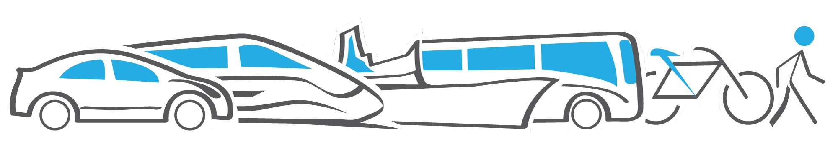
SUSTAINABLE MOBILITY
FOR ALL
Kenya Evidence Forum
Nancy Vandycke
June 14, 2016

Slide 2
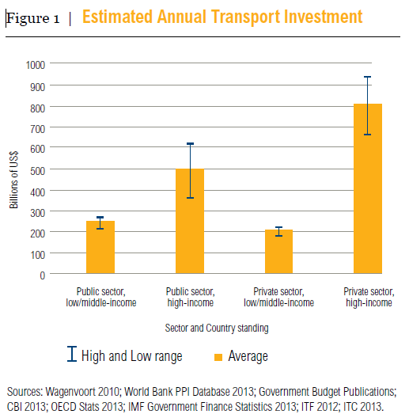
TRANSPORT INVESTMENTS
Investments are needed for sustainable new and existing transport systems
Global investments in public and private transport: $1.4-$2.1 trillion per year*
  Private investment = 58%
  ODA and Green Funds: 2%
  HIC: 75 %
Capital needs to achieve 2 degree scenario pathway:**
  $2 trillion
  $237 billion in BRT and rail investments
​
(*) Levefre B., and al. (2014), “The Trillion dollar question:
(**) Lefevre B, and al. (2016), “The Trillion dollar question II: tracking investment needs in transport” WRI

Slide 3
IN KENYA
ACTIVE PORTFOLIO ALL SECTORS
WBG | Net Commitments/ Committed ($m)
IDA | 4,131.1
IFC | 908.1
MIGA
World Bank Group | 5,039.2
TRANSPORT
Commitments
National Urban Transport Improvement | 300.00
Transport Sector Support Project | 503.50
Total | 803.50
Pipeline FY17/18
Kenya Rural Roads Project | 100.00
Airport Modernization Project | 0.06
Nairobi BRT Project | 250.00
Total | 350.06
Notes:
Overall investment of the transport sector in the country > US $2 billion
Largest investments:
KE-Northern Corridor Trnsprt SIL (FY04) > US $300
KE:Transport Sector Support Project > US $300
KE-National Urban Transport Improvement > US $300

Slide 4
GLOBAL CONTEXT
What does the future hold for us? By 2030,
3 billion more people on Earth, with rising aspirations for mobility
Dollar value of digital information flows already exceeds value of traded goods
Freight volume expected
to quadruple

Slide 5
CHALLENGES
Collective global efforts on sustainable mobility have so far been insufficient:
1
billion
people
70
% fuel
energy
1
billion
cars
32
% in road
deaths
23
% GHG
emissions
​Over 1 billion people have no access to an all-weather road
70 percent of fuel energy is lost in engine and driveline inefficiencies.
Number of vehicles on the road expected to double to 2 billion by 2050
Road death rate per 100,000 population increased 32% in Low Income Countries (from 18.3 in 2010 to 24.1 in 2013)
Transport is responsible for 23 percent of energy-related GHG emissions and this share is increasing

Slide 6

VISION
To facilitate Sustainable Mobility for All through four goals:
ACCESS
FOR ALL
EFFICIENCY
SAFETY
CLIMATE &
ENVIRONMENT
GOALS
Secure access for all to economic and social opportunities
Increase the efficiency of transport systems and services
Improve the
safety of mobility
(SDG target 3.6
on road safety)
Embed mitigation, adaptation, and environmental concerns
into supply as well as demand side
Progress on these goals will improve the lives and livelihoods of billions of people across the world—their health, their environment, their quality of life—and help stabilize climate change over the long term.
OUTCOMES

Slide 7
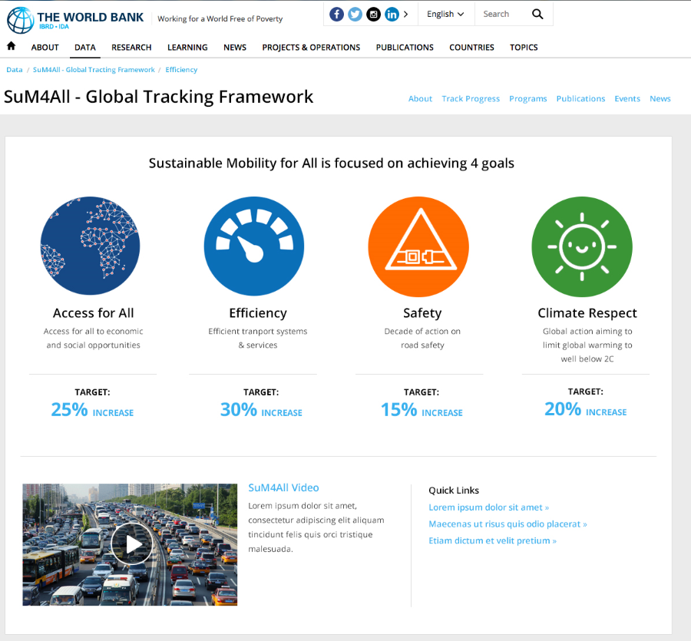
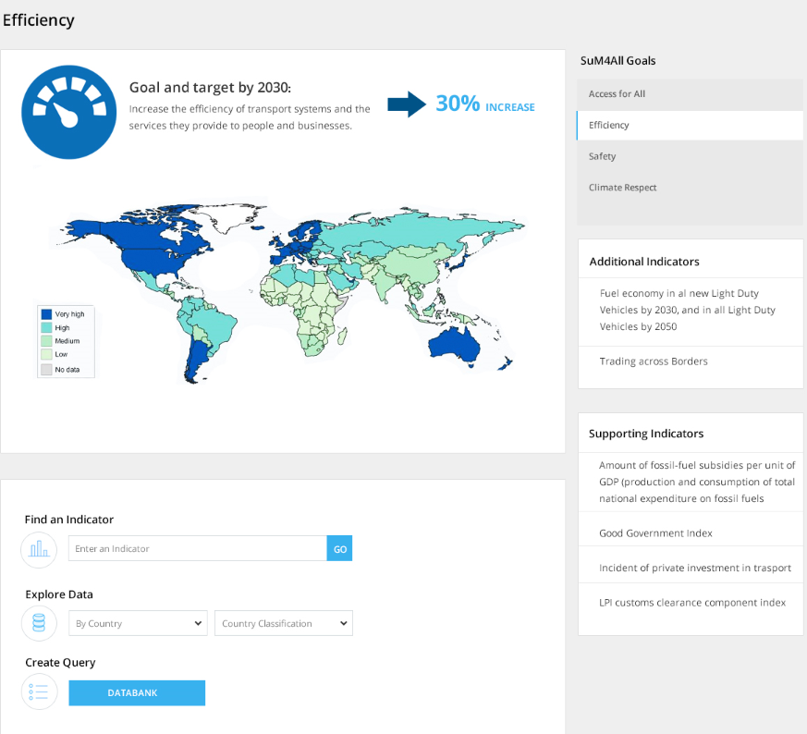
GLOBAL TRACKING FRAMEWORK
A global tracking framework (GTF) to measure progress towards the four goals, using country-level indicators.
Progress on each goal tracked using one principal, two additional, and other supporting indicators.
This GTF to be supported by a
partnership to develop, collect, and analyze data and indicators.

Slide 8
CALL FOR ACTION
Many actors have made voluntary financial and operational commitments:
COUNTRIES
CITIES
PRIVATE SECTOR
MDBs
LPAA/CIVIL SOCIETY
>70%
countries are targeting transport
in their
NDCs
>80
cities (affiliated with C40) are tackling climate change and climate risk
>260
transportation
companies pledged
to reduce GHG
emissions
>$175 billion
committed in loans
and grants for sustainable
transport
from 2013 to 2022
15
initiatives have committed to reducing carbon footprint across transport modes
Transforming the world’s mobility requires more. We need:
A robust global vision to guide us
Bold and ambitious actions
A global tracking framework to measure progress
Strengthen global coalitions to carry the agenda forward

Slide 9
BOLD AND AMBITIOUS ACTIONS
We need scale and focus to radically transform the movement of people and goods in the short, medium, and long-term.
In the short-term: a set of “quick-wins”, such as:
Expanding congestion/road charging in major global cities
Modernizing ageing rail fleets and traction systems
In the medium-term: actions, such as:
Dedicated funding for sustainable mobility in the Green Climate and Climate Investment funds
Rebalance urban public space in favor of non-motorized transport (bicycling and walking)
Accelerate the introduction of carbon pricing (including fuel subsidy reform)
Roll out safety technologies that can drastically reduce traffic accidents and fatalities
In the long-term: actions, such as a Global Roadmap for De-Carbonization of the Transport Sector

Slide 10
GLOBAL COALITION
We need to strengthen and expand existing coalitions of bold and committed actors drawn from a range of groups:
  National champions: Synergies with the SDGs and the Paris agreement (NDCs) can best be optimized at the country level.
  City champions: Cities are at the forefront of sustainable mobility and will be leading many of the sustainable mobility initiatives.
  Private sector champions: Private sector is likely to remain at the cutting edge of innovations and a key investor for sustainable transport.
  Civil society: Organizations promoting coordinated action are central.
  International actors: Organizations with international clout will be key sources of leadership and knowledge.
The role of these coalitions will be to share knowledge, advocate, galvanize action, and catalyze financing from the public and private sector for sustainable mobility.

Slide 11
SUSTAINABLE MOBILITY—THE WAY FORWARD
UNSG HLAG Sustainable Transport Meeting, Santiago. Engagement with HLAG on sustainable mobility
COP22, Morocco – and
UNSG HLAG ST Conference, Ashgabat - Recommendations on sustainable mobility endorsed
May 31
November
Climate Action Summit (Plenary). Conveners: UN Secretary General and WBG President. Dialogue on sustainable mobility. Plus Pre-Summit Stakeholders’ Workday – Transport Track, May 4
World Bank-IMF Annual Meetings - Dialogue with Ministers of Finance on sustainable mobility
May 5-6
October 7-9
International Transport Forum, Leipzig. Ministers of Transport. Dialogue on sustainable mobility
Habitat III Conference - Deep-dive on urban mobility
May 18-20
October
October 17-20
World Economic Forum, Davos – High level support for sustainable mobility for all
UN General Assembly.
High-level event
September 13-20
Jan 17-20, 2017
Work with Partners to Rally Supporting Voices

Slide 12
How can the IE Connect for Impact Contribute?
Better understand the economics of T&I interventions to achieve higher impact
Generate evidence on key topics at scale (conclusive results) to support the Narrative on sustainable transport
Make significant investments in knowledge generation in priority business areas (urban mobility, transport corridors, broadband access)
Establish the evidence basis for linking interventions with poverty reduction, growth and sustainable development
Pooling intellectual and financial resources to achieve scale (e.g., involve other MDBs to maximize cross-institutional learning spill-overs).

Slide 13

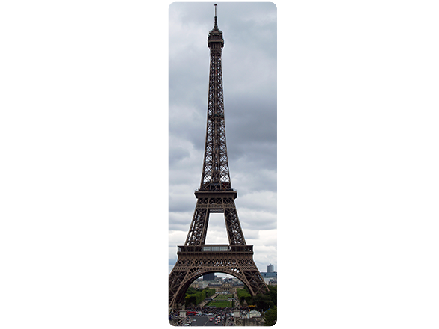
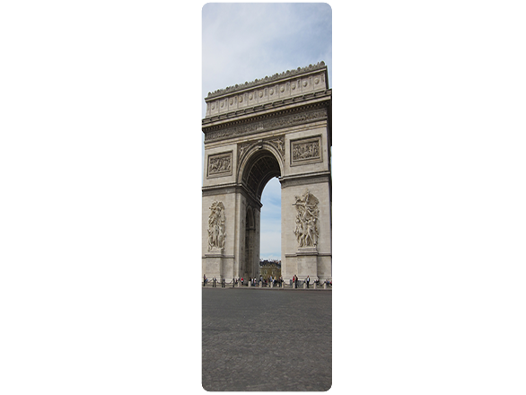








MDB’s RESPONSE
Rio+20 MDBs Pledge on Sustainable Transport
$175 billion 2012-22
On track
($65 billion)
Paris Commitment on Climate Finance
by MDBs, 2020*
AfdB: $5 billion
ADB: $6 billion
EIB: 35 %
(from 25%)
EBRD: 40 %
(from 20%)
IDB: 25-30 %
(from 14%)
WBG: 28 %
(from 21%)
Paris Joint MDBs commitment on Transport and Change

Slide 14
WORLD BANK RESPONSE
Transport Sector (FY11-15, USD Billions)
100%
WBG’s total commitment
for climate finance
$10.3 billion (2015) ➔ $29 billion (2020)
8
6.1
80%
6
4.6
60%
(USD Billions)
4.3
(Percentages of Commitments with climate co-benefits )
4
3.9
40%
3.1
WB Transport for climate finance
2
0.8
0.3
20%
1.8
2.0
0
1.3
0.9
1.1
0%
2011
2012
2013
2014
2015
transport commitments
with mitigation benefits
with adaptation benefits
2011-15 (actual)
US$7.8 billion
(26.4% of total transport commitment)
o/w adaptation = US$ 715 million
2015 (actual)
US$1.3 billion
o/w adaptation = $200 million
Projected 2016-2020
US$ 10.5 billion
(35% of total transport
commitment)
US$ 2.1 billion
Note: grey: transport commitments; red: with mitigation benefits; blue: with adaptation benefits)

